Slide 1

A Project on Cause of Death
By
Amita Saini
Internship Batch 34

Slide 2
Problem Statement
A straightforward way to assess the health status of a population is to focus on mortality – or concepts like child mortality or life expectancy, which are based on mortality estimates. A focus on mortality, however, does not take into account that the burden of diseases is not only that they kill people, but that they cause suffering to people who live with them. Assessing health outcomes by both mortality and morbidity (the prevalent diseases) provides a more encompassing view on health outcomes. This is the topic of this entry. The sum of mortality and morbidity is referred to as the ‘burden of disease’ and can be measured by a metric called ‘Disability Adjusted Life Years‘ (DALYs). DALYs are measuring lost health and are a standardized metric that allow for direct comparisons of disease burdens of different diseases across countries, between different populations, and over time. Conceptually, one DALY is the equivalent of losing one year in good health because of either premature death or disease or disability. One DALY represents one lost year of healthy life. So, in depth analysis is required to present data on cause of death.

Slide 3
Problem Statement
So, In depth analysis is required for spread and variation of causes of death across countries, year etc for conclusion.

Slide 4
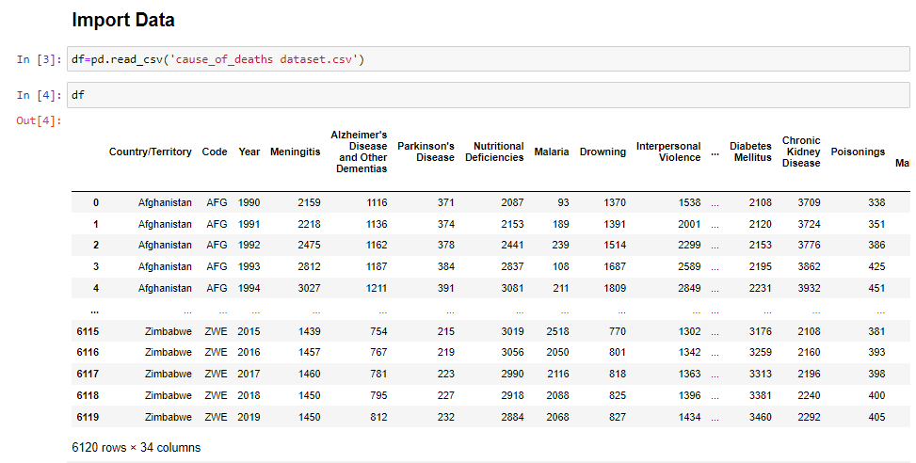
Data Sources and their formats
Data set provided by Flip Robo is in the format of CSV (Comma Separated Values). The dimension of data is 6120 rows and 34 columns.

Slide 5
Project Flow Tasks
Data Inspection of duplicate or any data error.
Missing values present in data set.
Feature Engineering for extraction of few new features out of existing features.
Feature selection
Splitting of dataset into input & target feature

Slide 6
Exploratory Data Analysis
key insight from dataset – from lot of features

Slide 7
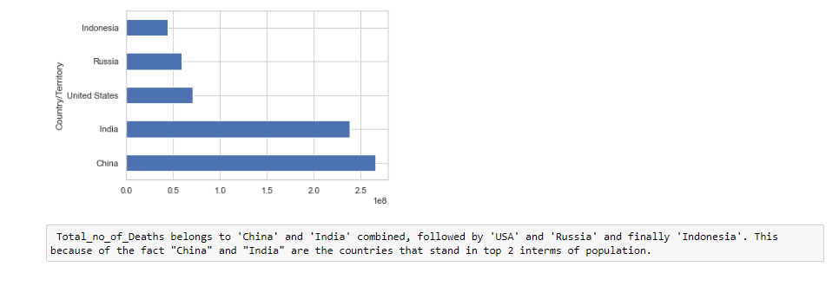

Slide 8
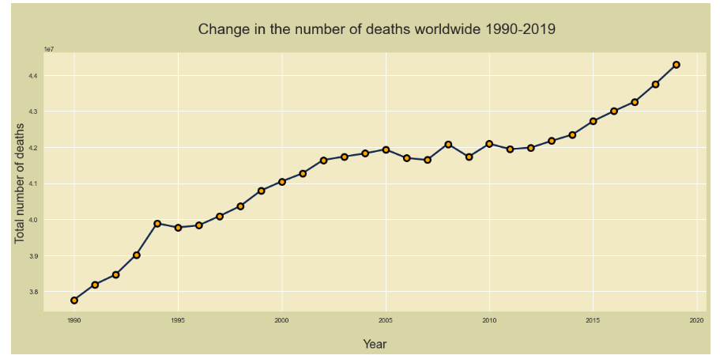
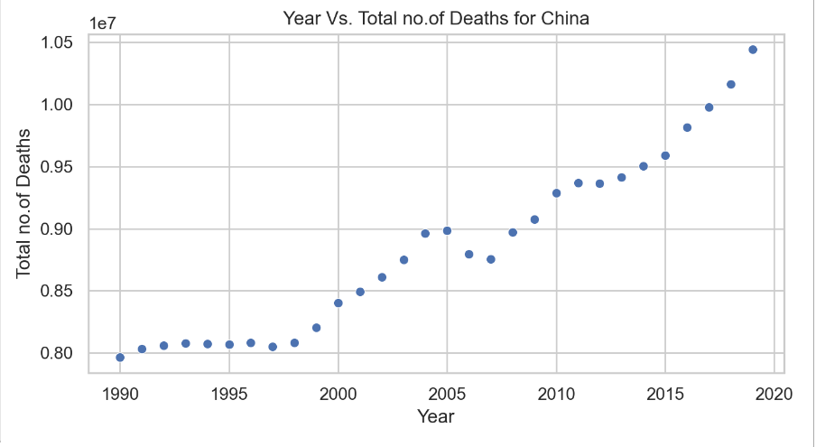

Slide 9
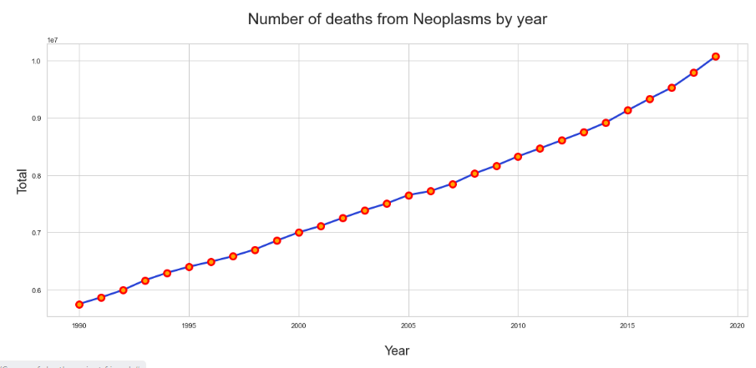
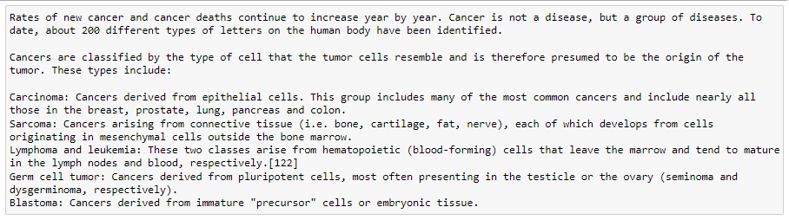

Slide 10
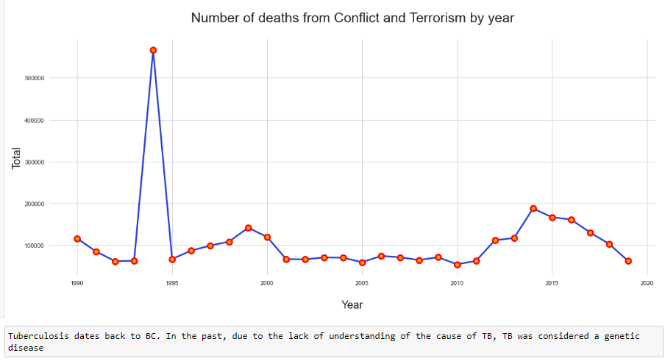
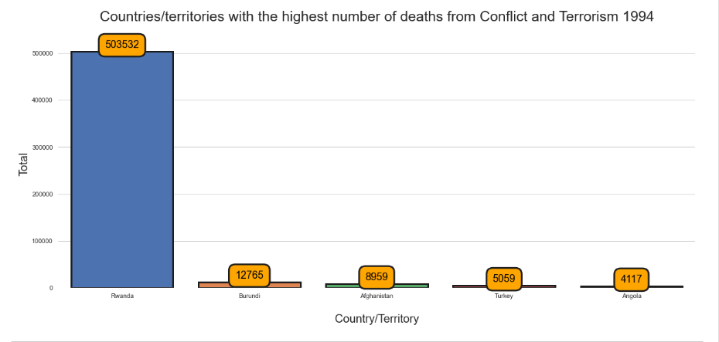
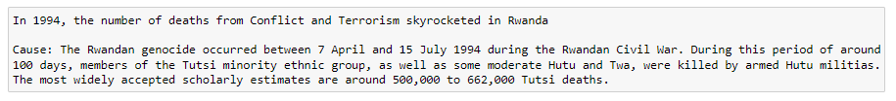

Slide 11
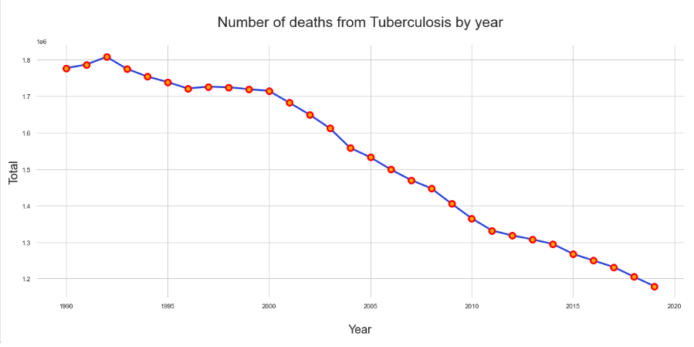
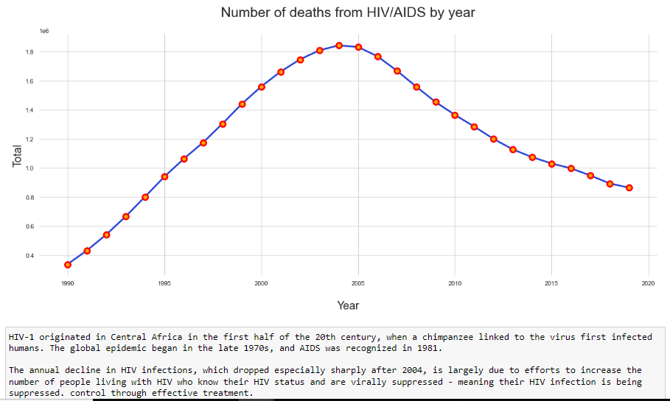

Slide 12
Key Findings and Conclusions

Slide 13

Key Findings and Conclusions

Slide 14
Thank You

